Slide 1
Global superstore Sales Performance Summary Report: Key Metrics, Insights, and Trends
Analyzing sales data to drive strategic business growth
Notes:
--- This presentation provides a detailed overview of sales performance, highlighting key metrics, insights, and trends across product categories and regions. It aims to equip stakeholders with actionable information to drive business growth.

Slide 2

Meeting Program
Executive Overview of Sales Performance
Insights by Product Category
Sales and Profit Trends Over Time
Regional Sales Performance Analysis
Top Products Driving Sales Success
Notes:
--- We will begin with an executive overview of sales performance, followed by insights by product category. Then, we will analyze sales and profit trends over time, examine regional sales performance, and conclude with the top products driving sales success. Image source: Microsoft 365 content library

Slide 3
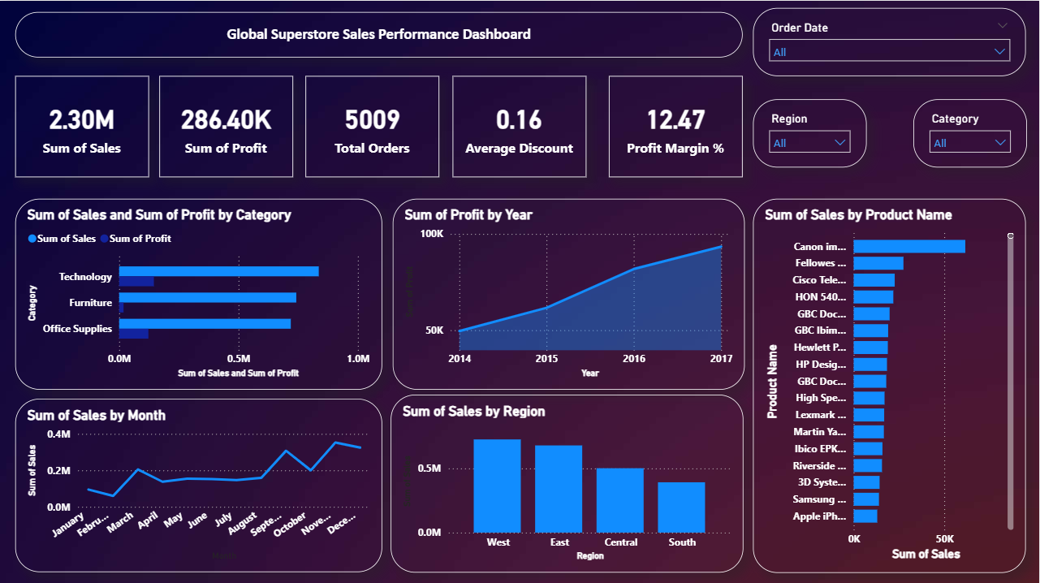

Slide 4
Executive Overview of Sales Performance

Slide 5
Summary of Total Sales, Profit, and Orders
Total Sales Overview
Aggregate sales figures reflect the company's revenue generated during the period. Tracking sales helps assess market demand and growth.
Profit Analysis
Total profits measure the financial gains after expenses, demonstrating the company's profitability and cost efficiency.
Orders Processed
The number of orders processed indicates operational volume and customer demand, impacting production and supply chain decisions.
Notes:
--- We review the aggregate sales figures, total profits generated, and the number of orders processed. These metrics provide a snapshot of the company’s overall performance. Image source: Microsoft 365 content library

Slide 6
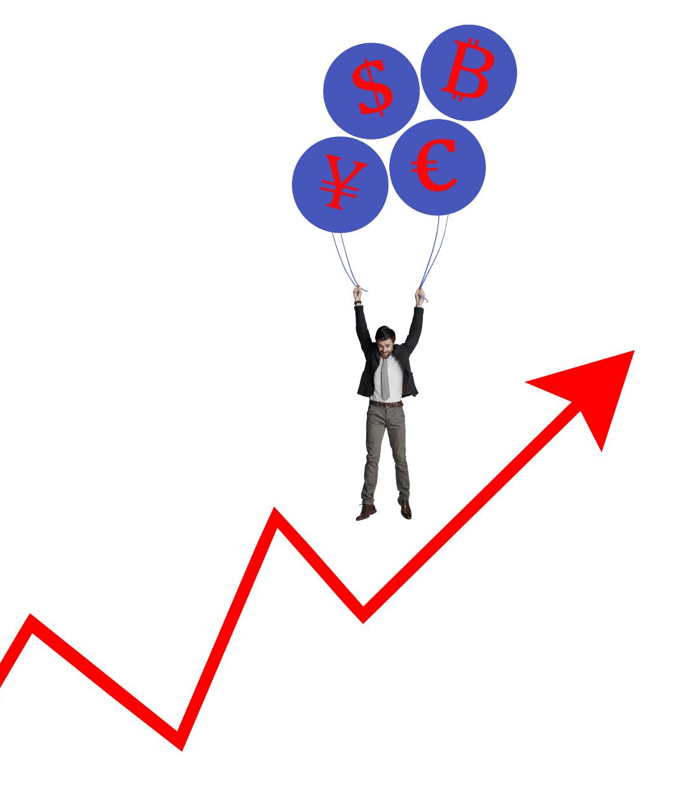
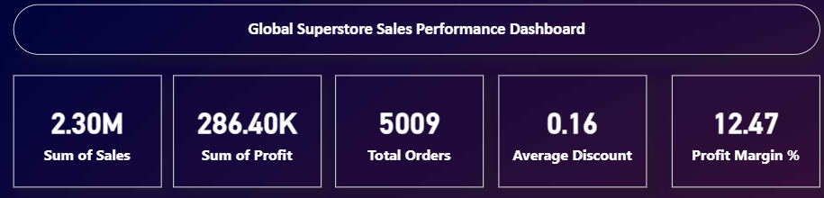
Analysis of Average Discount and Profit Margin
Discount Impact on Profits
Examining how varying average discount levels influence overall profit margins in business operations.
Pricing Effectiveness
Understanding how discount strategies affect pricing effectiveness and contribute to revenue generation.
Profitability Dynamics
Analyzing the dynamic relationship between discount rates and profitability to optimize business decisions.
Notes:
--- This slide analyzes the impact of average discount levels on profit margins, helping to understand pricing effectiveness and profitability dynamics. Image source: Microsoft 365 content library

Slide 7
Insights by Product Category
Notes:
This section dives into sales and profit performance across different product categories: Technology, Furniture, and Office Supplies, illustrating their contributions to overall results.

Slide 8
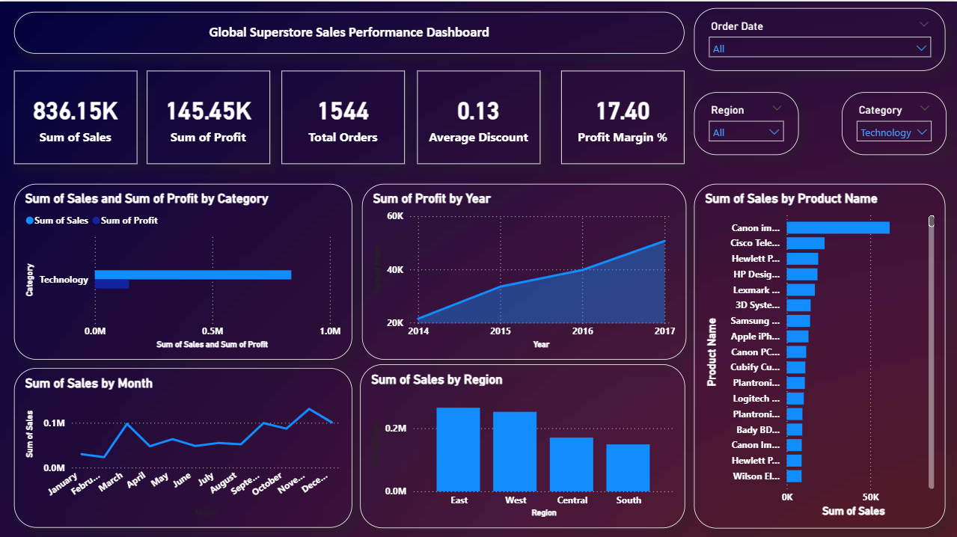
Technology: Highest Sales and Profit Contribution
Leading Sales Volume
Technology products dominate sales volume, indicating strong consumer demand and market presence.
Profit Contribution
Technology category contributes the highest profits, driving significant business growth and sustainability.
Notes:
--- Technology products lead in both sales volume and profit contribution, proving to be the strongest category driving business growth. Image source: Microsoft 365 content library

Slide 9
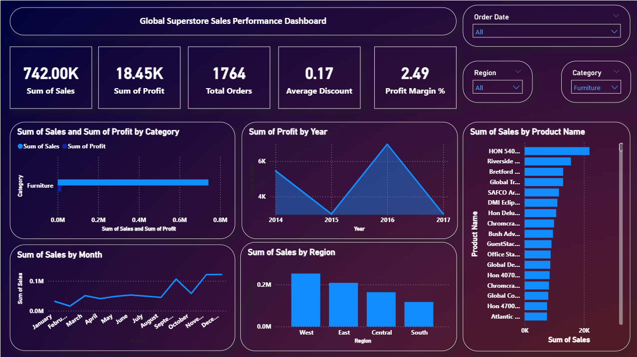
Furniture: Significant Sales with Moderate Profits
Strong Sales Performance
Robust sales totaling $742K
Reflects strong market demand and consistent customer interest
Low Profit Margins
Profit: $18.45K | Margin: 2.49%
High discount of 17% likely affecting profitability
Optimization Opportunities
Reduce discounts on high-demand items
Improve cost efficiency in sourcing & logistics
Refine pricing strategy to boost margins
Notes:
--- Furniture shows strong sales figures but yields moderate profit margins, indicating potential areas to optimize cost or pricing strategies. Image source: Microsoft 365 content library

Slide 10
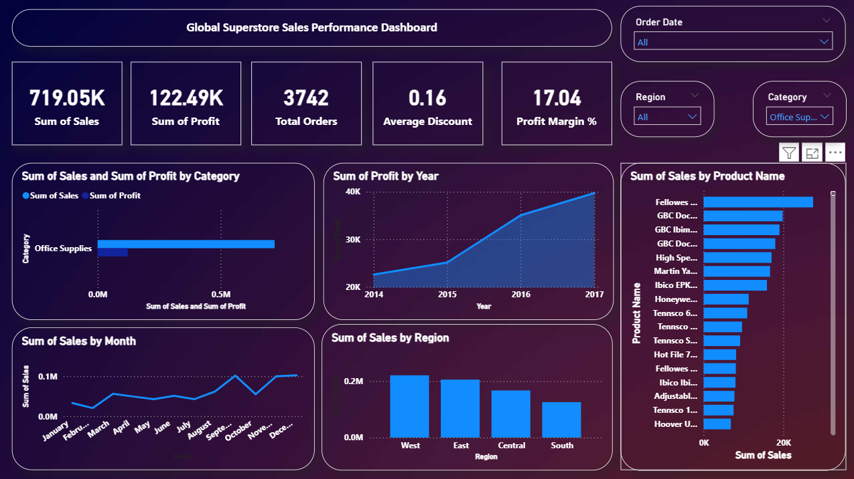
Office Supplies: Lower Sales and Profit Compared to Other Categories
Strong Sales Performance
Office Supplies category shows solid sales performance, indicating steady market demand and consistent customer interest.
Healthy Profit Margins
The category maintains healthy profit margins, suggesting a balanced pricing and cost structure, even with moderate discounting.
Optimization Opportunities
Slight reduction in discounting could further enhance profitability
Explore cost-saving opportunities in sourcing or operations
Continue refining pricing strategies to maintain competitiveness
Notes:
--- Office Supplies category contributes less in both sales and profit, suggesting opportunities for targeted marketing or product adjustments. Image source: Microsoft 365 content library

Slide 11
Sales and Profit Trends Over Time
Notes:
This section examines profit growth over years, monthly sales patterns, and factors influencing these trends to better understand temporal dynamics.

Slide 12
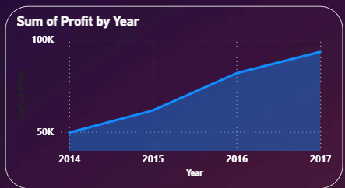
Yearly Profit Growth From 2014 to 2017
Trend Analysis Overview
Examining profit growth trends reveals important periods of acceleration and decline between 2014 and 2017.
Strategic Decision Insights
Identifying profit fluctuations helps guide strategic business decisions and future planning.
Notes:
--- We analyze yearly profit growth trends during this period, identifying periods of acceleration or decline to inform strategic decisions. Image source: Microsoft 365 content library

Slide 13
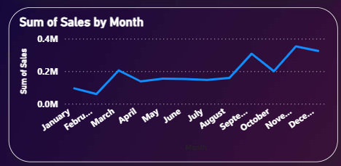
Monthly Sales Trends and Peak Months
Seasonal Sales Patterns
Monthly sales data displays clear seasonal peaks and troughs reflecting demand changes throughout the year.
Inventory Planning Benefits
Understanding sales cycles helps optimize inventory to meet demand efficiently and reduce excess stock.
Marketing Strategy Alignment
Aligning marketing efforts with sales peaks boosts campaign effectiveness and maximizes revenue opportunities.
Notes:
--- Monthly sales data reveals seasonal peaks and troughs, enabling better inventory and marketing planning aligned with demand cycles. Image source: Microsoft 365 content library

Slide 14
Driving Factors Behind Observed Trends
Market Conditions Impact
Market conditions significantly influence sales and profitability by affecting customer demand and competition.
Product Launch Effects
New product launches drive sales growth and can shift profit trends by attracting new customers.
Promotional Campaign Influence
Promotional campaigns increase brand visibility and stimulate short-term sales boosts impacting profit trends.
Notes:
--- This slide discusses key drivers such as market conditions, product launches, or promotional campaigns that have influenced sales and profit trends. Image source: Microsoft 365 content library

Slide 15
Regional Sales Performance Analysis
Notes:
We review sales performance by region, highlighting top performers and areas with growth opportunities to support regional strategies.

Slide 16
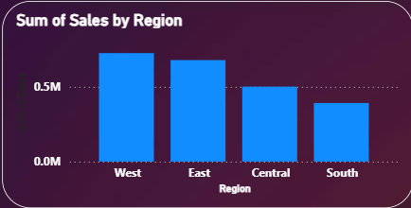
West and East: Top Performing Regions
Leading Sales Regions
The West and East regions demonstrate the highest sales performance across all markets.
Strong Market Presence
These regions show strong market presence, driving significant customer engagement and loyalty.
Notes:
--- The West and East regions lead in sales performance, showcasing strong market presence and customer engagement. Image source: Microsoft 365 content library

Slide 17

Central: Moderate Sales Contribution
Steady Sales Performance
The central region shows consistent sales figures, reflecting stable market presence and customer base.
Moderate Sales Contribution
Sales from the central region contribute moderately to overall company revenue, helping maintain balance.
Growth Potential
There is significant potential for increased sales growth in the central region through targeted strategies.
Notes:
--- Central region delivers moderate sales results, indicating steady performance with potential for further growth. Image source: Microsoft 365 content library

Slide 18
South: Lowest Regional Sales and Opportunities for Growth
Lowest Sales Performance
The South region has the lowest sales figures compared to other regions, indicating underperformance in this market.
Targeted Marketing Efforts
Focused marketing campaigns are needed to boost sales and address the specific challenges of the South region.
Expansion Initiatives
Growth opportunities exist through expansion and investment in the South region to improve market share.
Notes:
--- South region records the lowest sales figures, highlighting it as a key area for targeted marketing efforts and expansion initiatives. Image source: Microsoft 365 content library

Slide 19
Top Products Driving Sales Success
Notes:
This section focuses on leading products contributing to sales, their performance, and growth opportunities among top sellers.

Slide 20

Canon: Leading Product in Sales
Top-Selling Product
Canon is recognized as the leading product in sales, dominating its market segment with strong performance.
Revenue Contribution
Canon significantly contributes to the company's overall revenue, highlighting its importance to financial success.
Market Share Impact
Canon's sales dominance boosts market share, strengthening the company's position in the competitive landscape.
Notes:
--- Canon stands out as the top-selling product, significantly contributing to revenue and market share. Image source: Microsoft 365 content library

Slide 21

Fellowes, Cisco, and HON 540: Strong Contributors
Consistent Product Performance
Fellowes, Cisco, and HON 540 products show steady, reliable sales performance over time.
Sales Support Role
These products support the overall sales success by complementing leading product offerings effectively.
Notes:
--- These products consistently perform well, supporting overall sales success and complementing top product offerings. Image source: Microsoft 365 content library

Slide 22

Opportunities for Growth Among Top Products
Cross-Selling Strategies
Cross-selling encourages customers to buy complementary products, enhancing total sales value effectively.
Upselling Techniques
Upselling promotes higher-value product options to maximize revenue from existing customers.
New Market Penetration
Entering new markets expands customer base and drives significant growth opportunities for top products.
Notes:
--- This slide identifies strategies to further leverage top products for increased sales, including cross-selling, upselling, and new market penetration. Image source: Microsoft 365 content library

Slide 23
Conclusion
Strong Sales Performance
Sales growth is driven by key products and regions contributing significantly to overall success.
Growth Opportunities
Identified opportunities across categories and geographies can help sustain and accelerate future growth.
Notes:
In summary, the report highlights robust sales performance led by key products and regions, while identifying opportunities across categories and geographies to sustain growth.

